Slide 1

Strategies to Confront Hallucinations
Bhavishya Pandit

Slide 2




Strategies to Confront Hallucinations
What is Hallucination?
Hallucinations refer to instances where the model generates text that appears plausible but is factually incorrect or internally inconsistent with the real world.
Why does it happen?
How to resolve?
Biases in training data
Lack of context
Improve data quality
Using RAG
The issue arises from constraints in the way Large Language Models (LLMs) handle information. These models undergo training with extensive volumes of text data, where inconsistencies or biases may exist. Consequently, the model might learn and unintentionally reproduce these patterns, resulting in outputs that appear authentic but are not.
RAG stands for Retrieval-Augmented Generation. It's a technique for improving the accuracy of large language models by letting them access relevant information from external sources before generating a response.

Slide 3



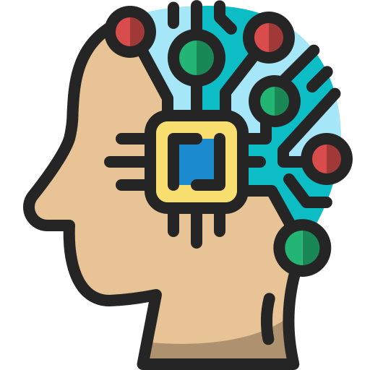


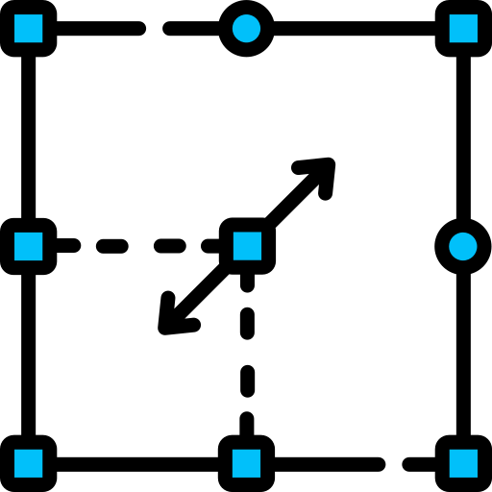
Simple RAG Architecture
What is RAG?
RAG stands for Retrieval-Augmented Generation. It's a technique for improving the accuracy of large language models by letting them access relevant information from external sources before generating a response there by controlling Large Language Models from Hallucinating.
Simple Architecture
Embedding Model
Documents
User question
Retrieved Context
LLM
Answer
Vector Database
Vector embeddings
Retrieval
Augmentation
Generation

